Slide 1
Intro to Analysis
Goal: Be able to quickly answer elementary questions about your product data
Notes:
I started writing slides for this course describing precise underlying theory of both statistics and R. After I finished the first several I decided it was a terrible approach. Analysis is like playing the guitar…learn some songs you can play first then fill in with theory and scales as needed.

Slide 2
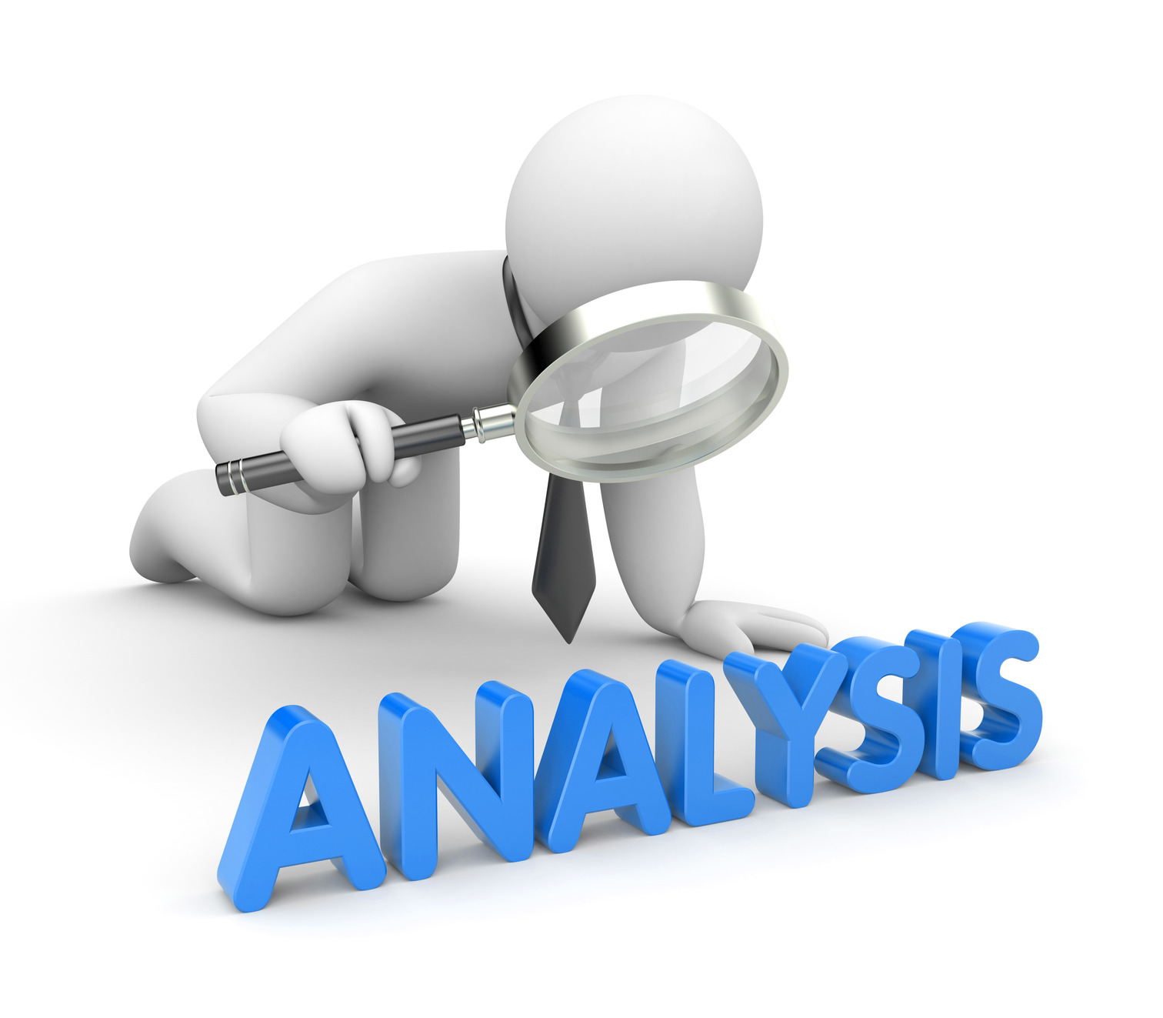




Intro to Analysis
Informal
Goals:
U

Slide 3


Intro to Analysis
Notes:
I started writing slides for this course describing precise underlying theory of both statistics and R. After I finished the first several I decided it was a terrible approach. Analysis is like playing the guitar…learn some songs you can play first then fill in with theory and scales as needed.

Slide 4
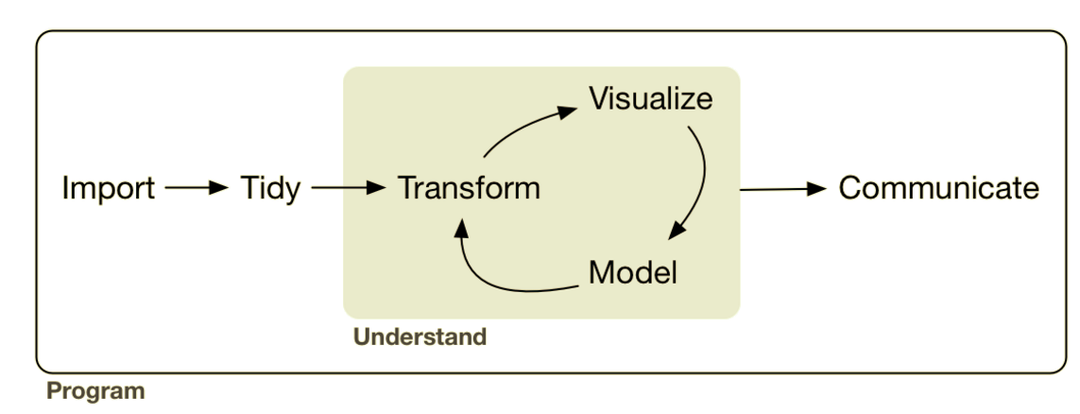
Intro to R: Analysis
Notes:
I started writing slides for this course describing precise underlying theory of both statistics and R. After I finished the first several I decided it was a terrible approach. Analysis is like playing the guitar…learn some songs you can play first then fill in with theory and scales as needed.

Slide 5
Intro to R: Analysis
Notes:
I started writing slides for this course describing precise underlying theory of both statistics and R. After I finished the first several I decided it was a terrible approach. Analysis is like playing the guitar…learn some songs you can play first then fill in with theory and scales as needed.

Slide 6




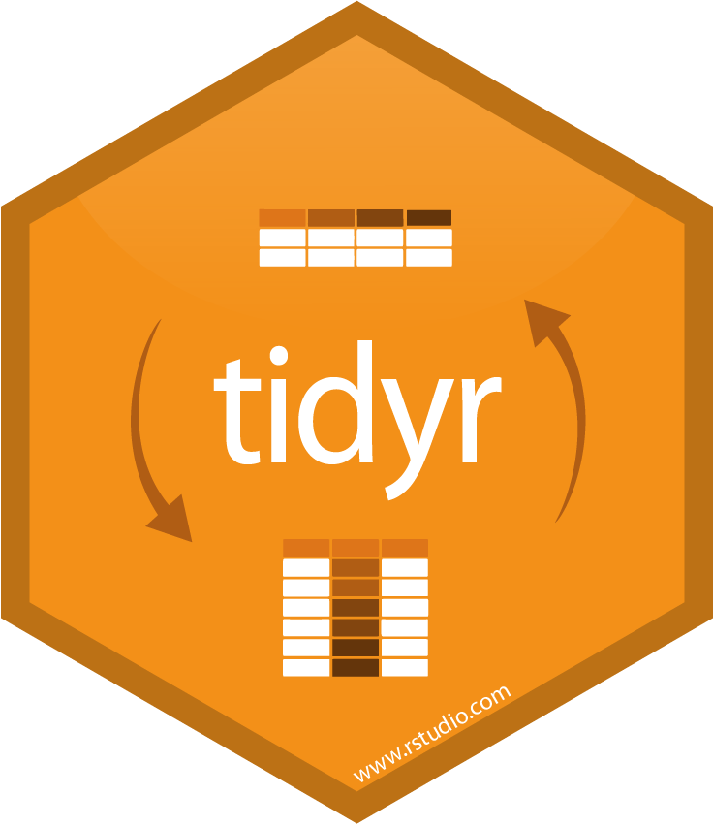
Intro to R: Analysis
sql ops
Notes:
I started writing slides for this course describing precise underlying theory of both statistics and R. After I finished the first several I decided it was a terrible approach. Analysis is like playing the guitar…learn some songs you can play first then fill in with theory and scales as needed.

Slide 7

Visualization

Slide 8
Let’s Code!

Slide 9
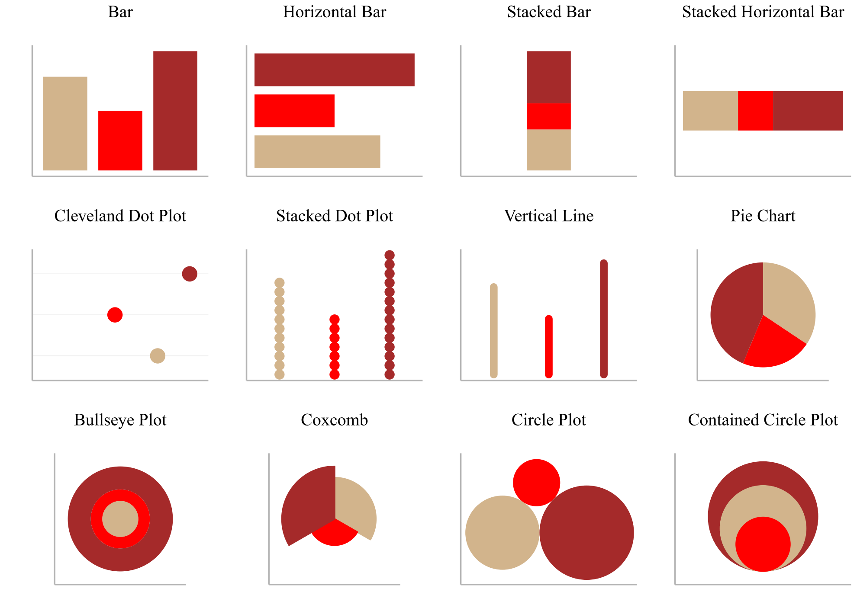
ggplot2: Layered Grammar
of Graphics
Grade | Passing
6 | 11
7 | 7
8 | 14

Slide 10
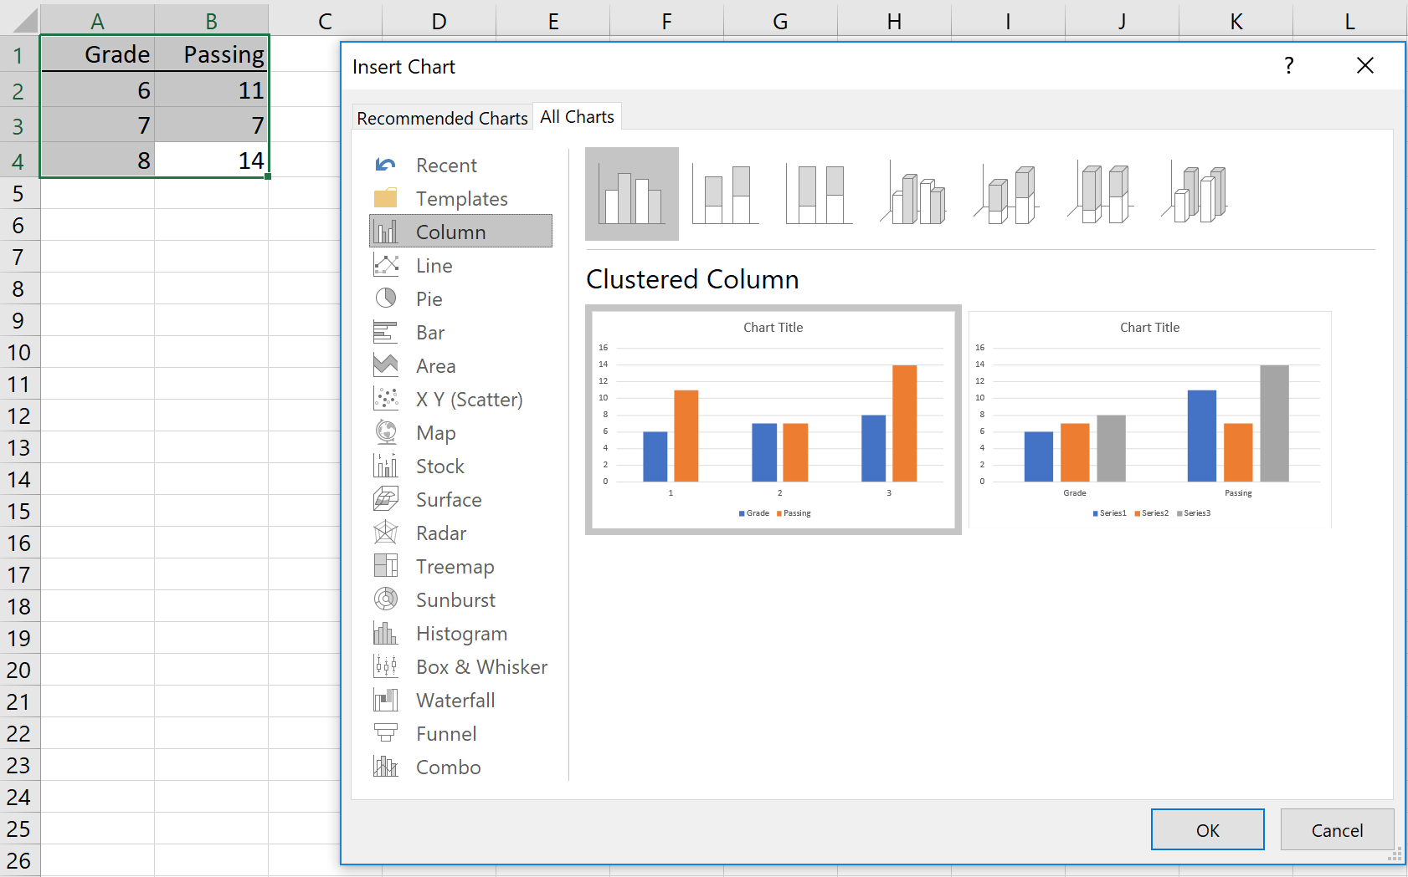
excel: Presets Choices
of Graphics
Grade | Passing
6 | 11
7 | 7
8 | 14

Slide 11

GUI Presets vs. Grammar
Thanks so much.
I really appreciate…
Excuse me.
I’m sorry.
What do you think?
How does that sound?
That sounds great.
(Oh) never mind.
I’m learning English.
I don’t understand.
Could you repeat that please?
Could you please talk slower?
Thank you. That helps a lot.
What does ~ mean?
How do you spell that?
What do you mean?
Hi! I’m [Name]. (And you?)
Nice to meet you.
Where are you from?
What do you do?
What do you like to do (in your free time)?
What’s your phone number?
Do you have Facebook?
How can I help you?
I’ll be with you in a moment.
What time is our meeting?
Please call me (back) at…
(Oh really?) Actually, I thought…
Actually, I [verb]…
I’m (just) about to [verb]…
Data
Plot Type
Style
Visual
Data
Geoms
Aesthetics
Statistics
Positions
Facets
Coordinates
Scales
Themes
Visual
Plot
Notes:
p_load(rvest)
tops <- 'https://www.fluentu.com/blog/english/basic-english-phrases' %>%
read_html() %>%
html_nodes('h4') %>%
html_text()
cat(gsub('^\\d+\\.\\s+', '', tops), file = 'clipboard', sep ='\n'

Slide 12
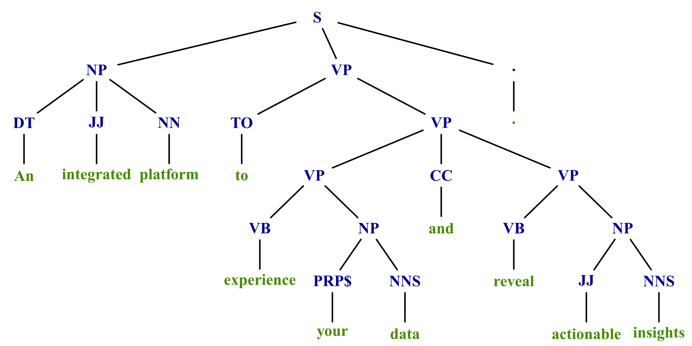
GUI Presets vs. Grammar
Data
Plot Type
Style
Visual
Data
Geoms
Aesthetics
Statistics
Positions
Facets
Coordinates
Scales
Themes
Visual

Slide 13
Let’s Code!

Slide 14
GUI Presets vs. Grammar
Data
Geoms
Aesthetics
Statistics
Positions
Facets
Coordinates
Scales
Themes
Visual
Any graph that isn't one Excel natively produces (like the Sankey or dendrograms in general).
Any graph that combines elements of different types of graphs or that combines multiple factors.

Slide 15
GUI Presets vs. Grammar
Data
Geoms
Aesthetics
Statistics
Positions
Facets
Coordinates
Scales
Themes
Visual
Any graph that isn't one Excel natively produces (like the Sankey or dendrograms in general).
Any graph that combines elements of different types of graphs or that combines multiple factors.

Slide 16
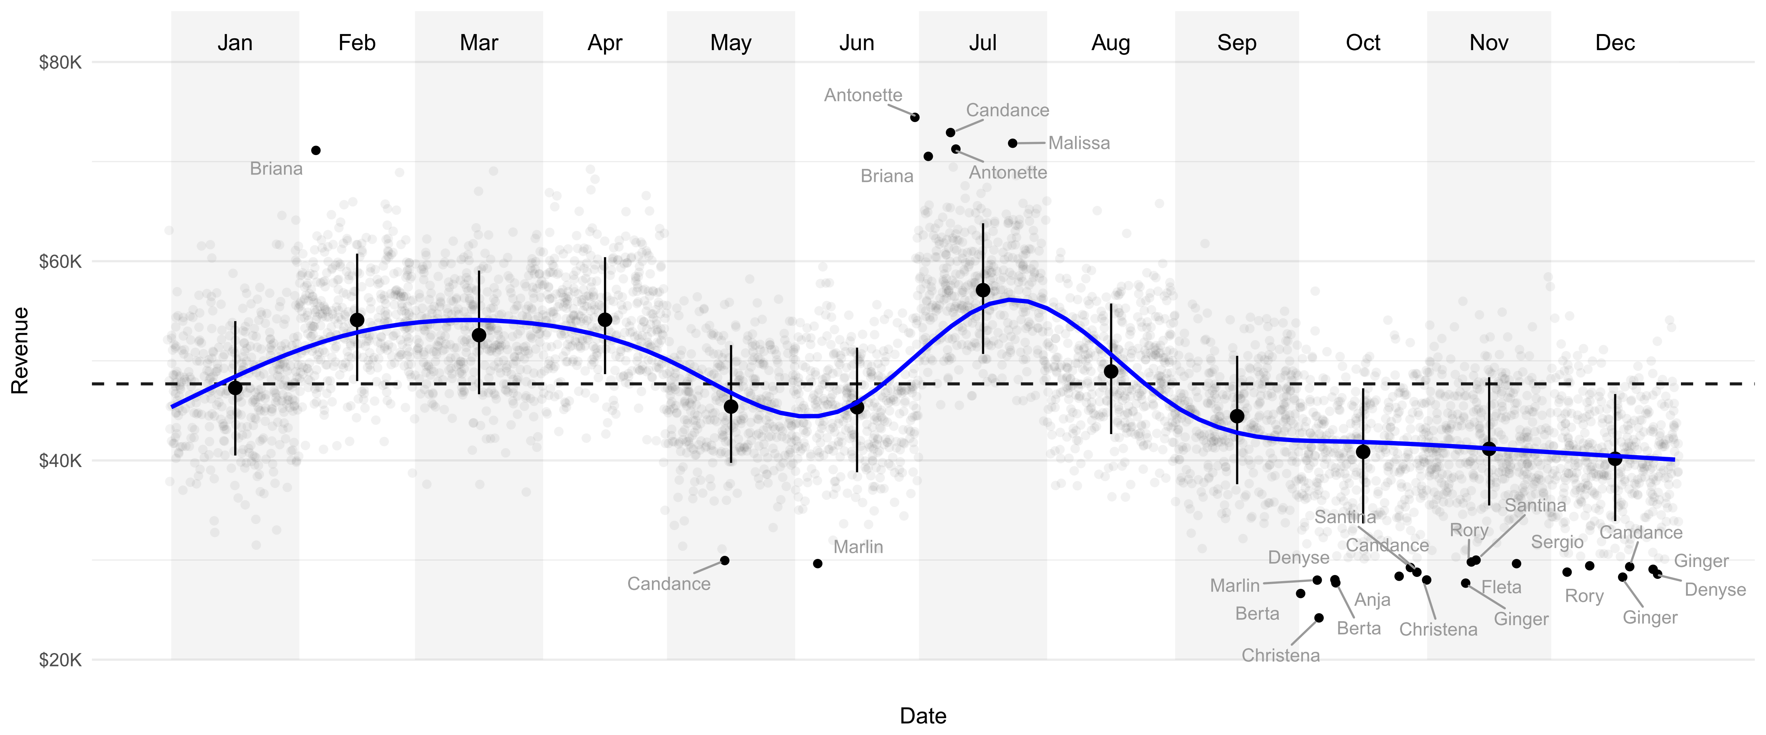
GUI Presets vs. Grammar
Data
Geoms
Aesthetics
Statistics
Positions
Facets
Coordinates
Scales
Themes
Visual
Any graph that isn't one Excel natively produces (like the Sankey or dendrograms in general).
Any graph that combines elements of different types of graphs or that combines multiple factors.

Slide 17
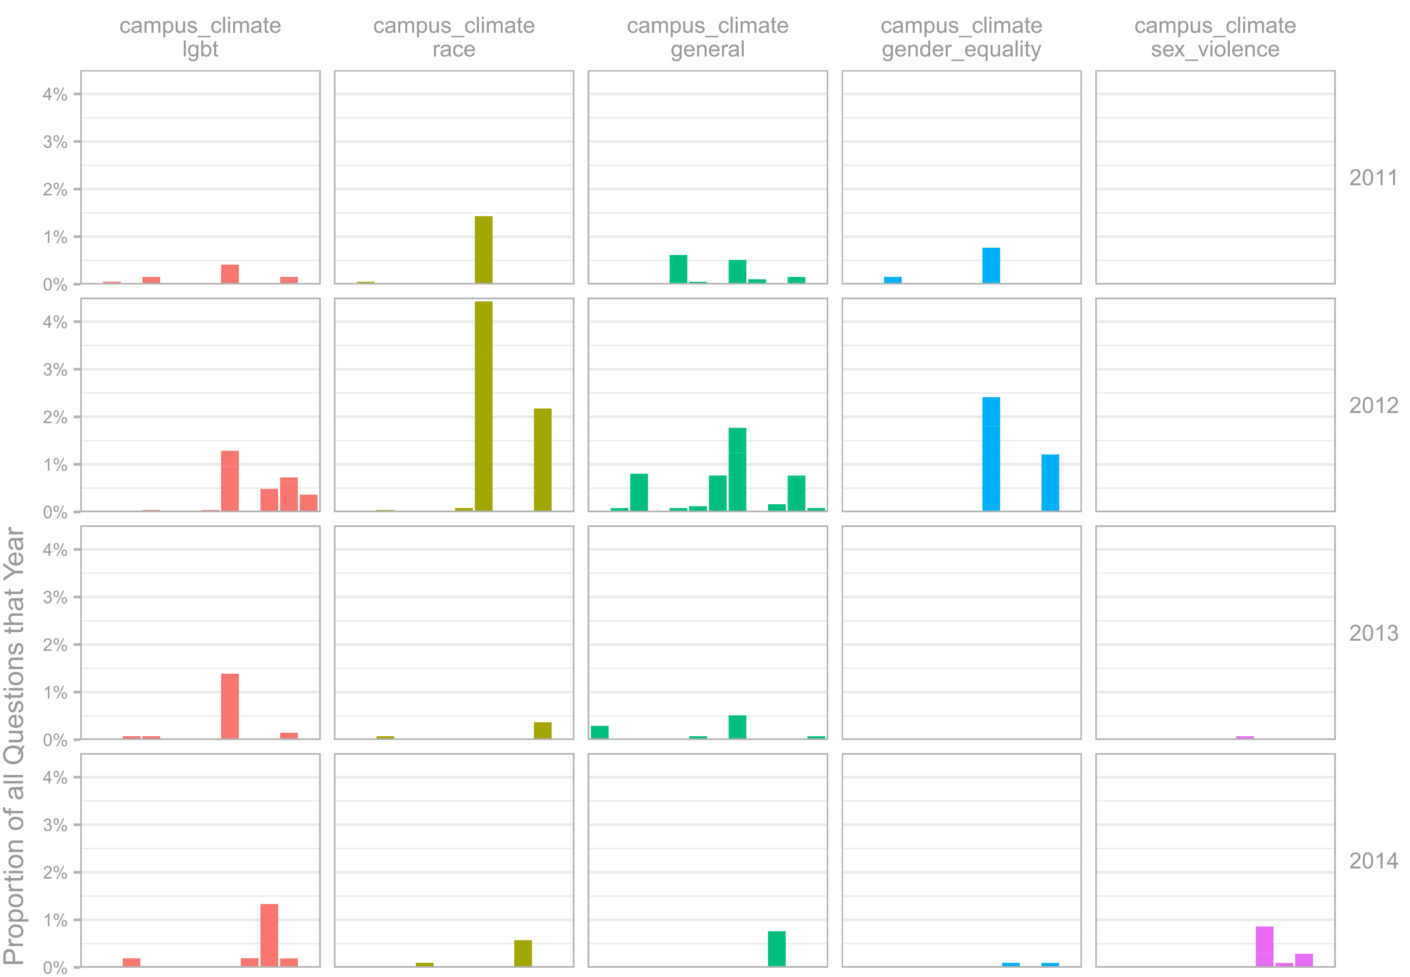
GUI Presets vs. Grammar
Data
Geoms
Aesthetics
Statistics
Positions
Facets
Coordinates
Scales
Themes
Visual
Any graph that isn't one Excel natively produces (like the Sankey or dendrograms in general).
Any graph that combines elements of different types of graphs or that combines multiple factors.

Slide 18
GUI Presets vs. Grammar
Data
Geoms
Aesthetics
Statistics
Positions
Facets
Coordinates
Scales
Themes
Visual

Slide 19
GUI Presets vs. Grammar
Data
Plot Type
Style
Visual
Data
Geoms
Aesthetics
Statistics
Positions
Facets
Coordinates
Scales
Themes
Visual
Notes:
Data geoms and aesthetics = nouns, verbs, and adjectives

Slide 20
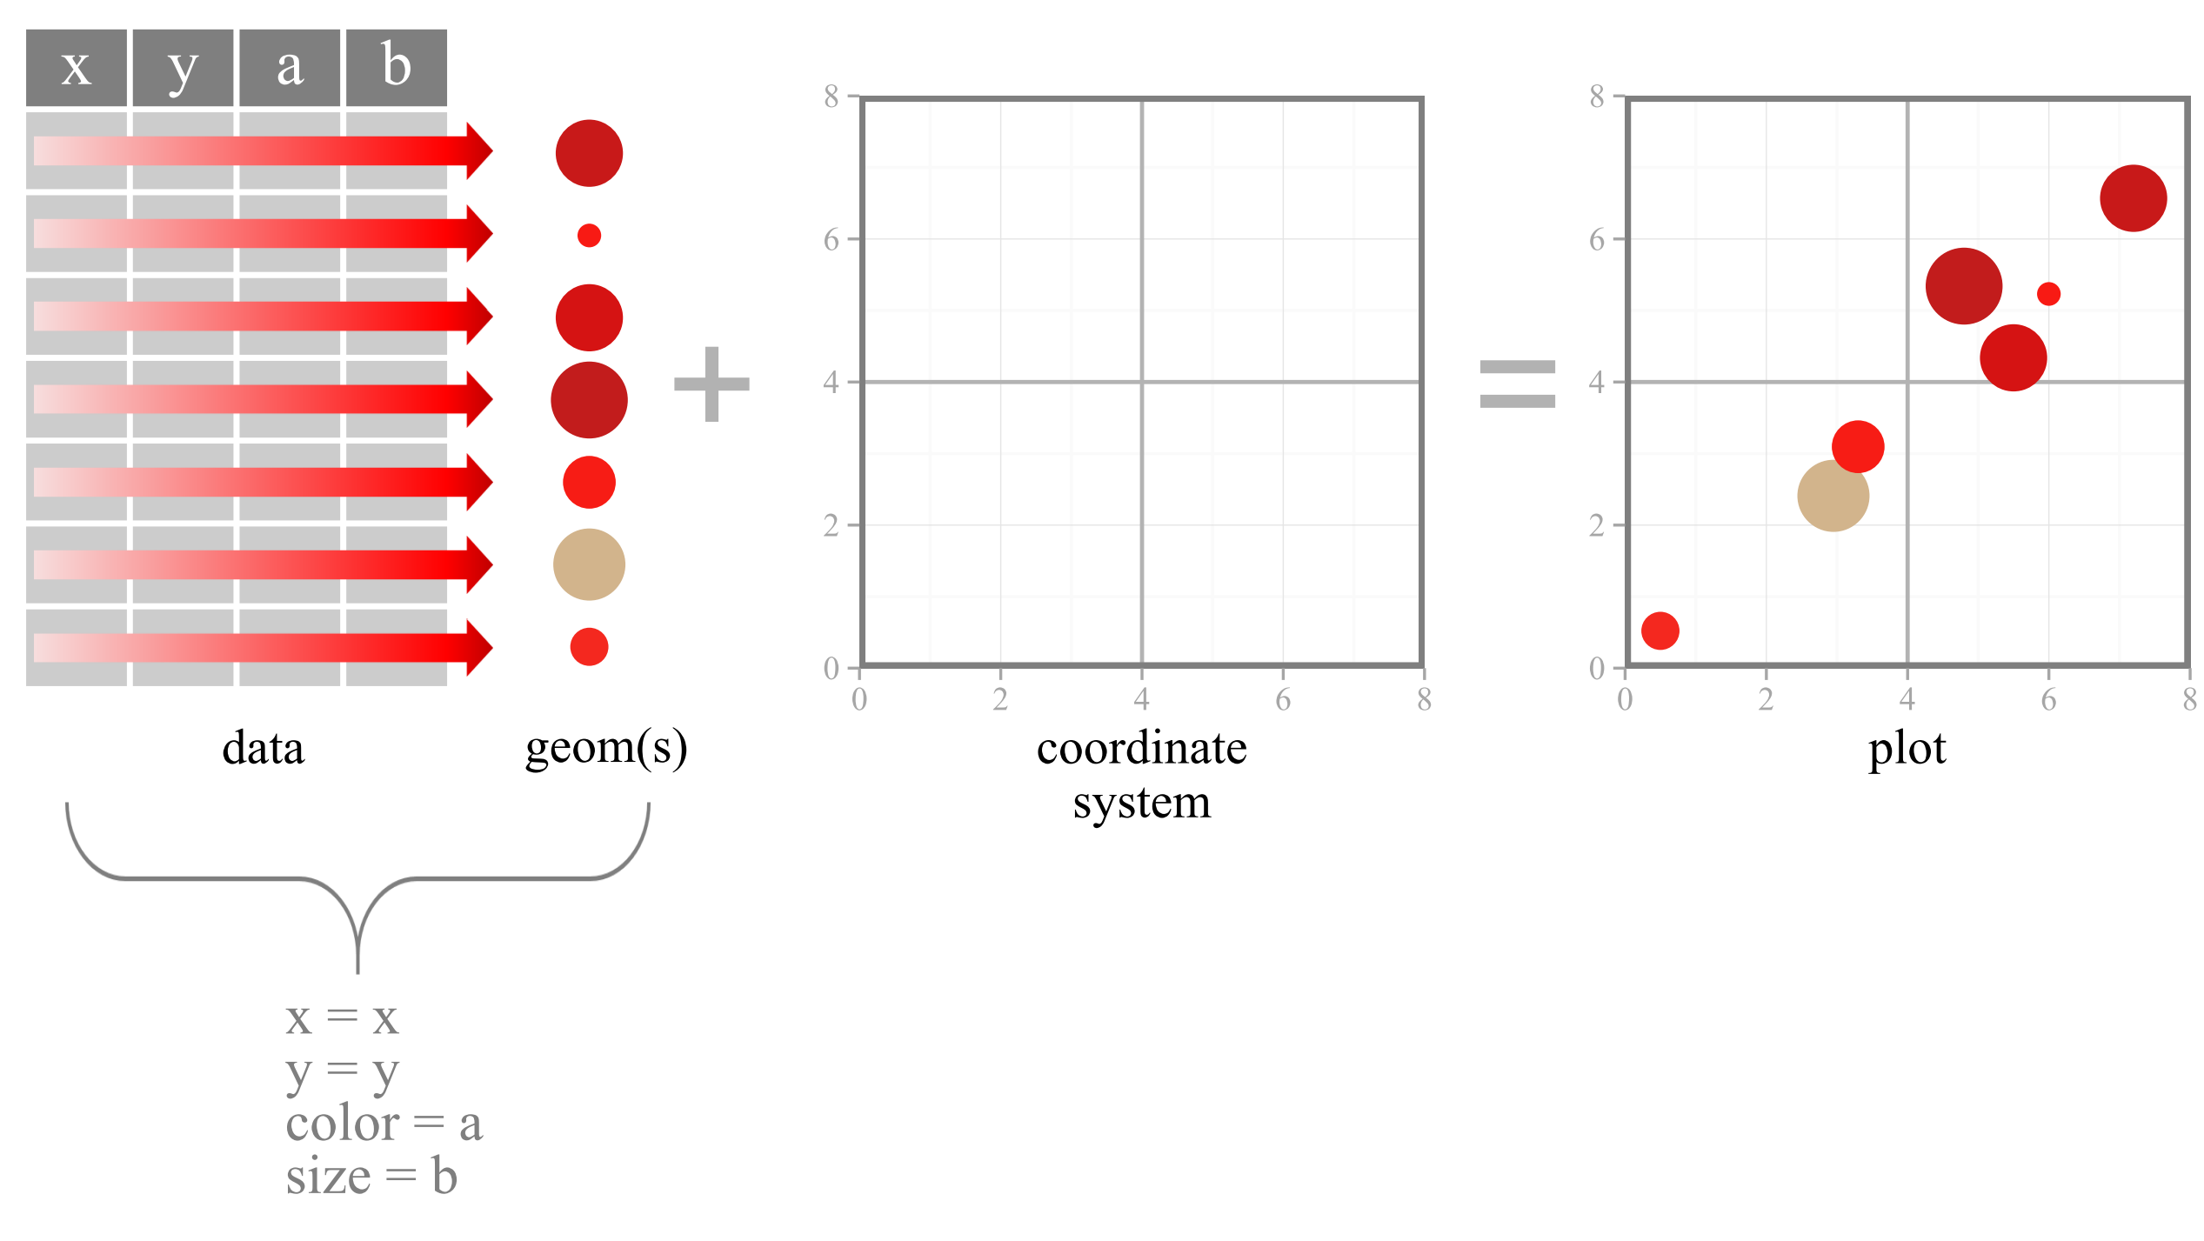
aesthetics

Slide 21
data
geom(s)
aesthetics

Slide 22
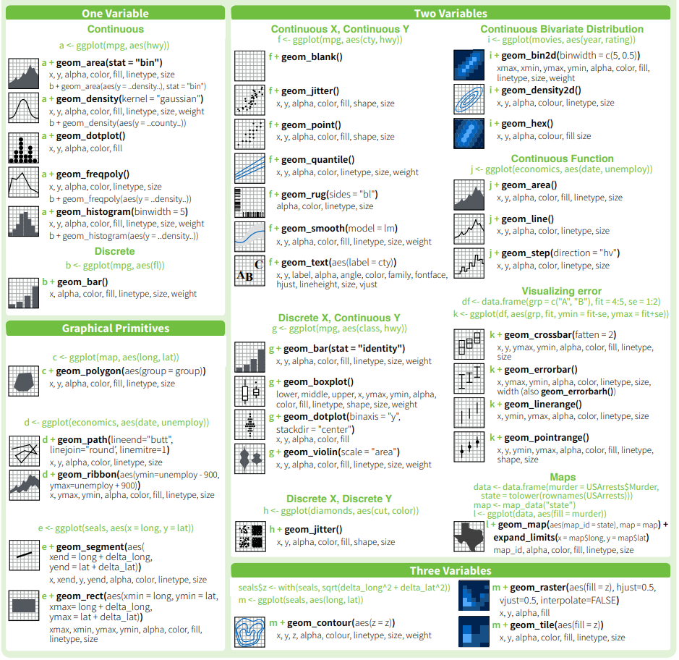
ggplot2: Geoms
Geometric Shapes

Slide 23
ggplot2: Geoms
Geometric Shapes

Slide 24
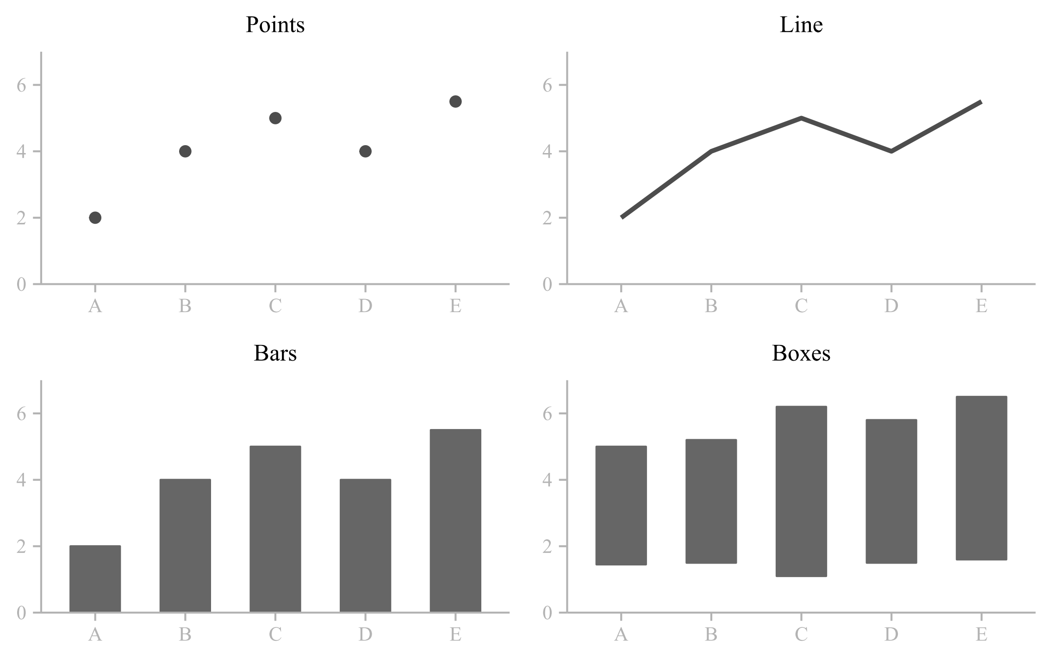
ggplot2: Geoms (most of the time)

Slide 25

ggplot2: Geoms (most of the time)
Without aesthetics geoms are nothing!!!

Slide 26
ggplot2: Aesthetics (control what geoms look like and where they go)
point
shape
fill
stroke
position
(x & y)
alpha
size

Slide 27
ggplot2: Aesthetics
point
shape
fill
stroke
position
(x & y)
alpha
size

Slide 28
ggplot2: Mapping (data to geom aesthetics)
aesthetics

Slide 29
ggplot2: Mapping (unmapped aesthetics: blue)
color = " blue "
aesthetics

Slide 30
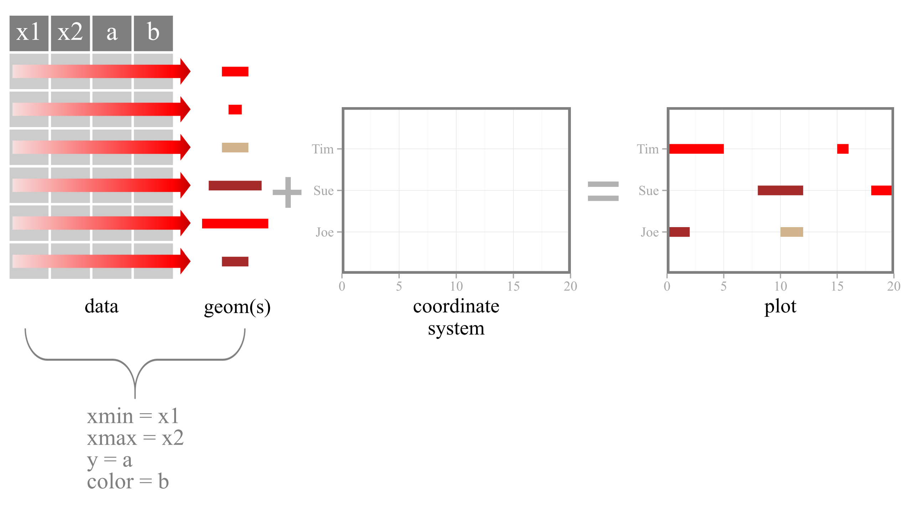
ggplot2: Mapping (bar geom)
aesthetics

Slide 31
Let’s Code!

